Slide 1

Target
By Audrey

Slide 2
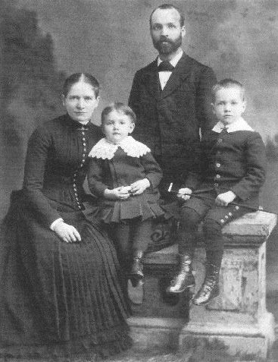
Background
The founder of target is George dayton
Target was founded June 24, 1902

Slide 3

Industry
Targets industry is retail sector

Slide 4

Publicly traded
Yes it is publicly traded
One stock is$104.32

Slide 5
revenue
-TargeTargets revenue is $106.566 billion in 2025
-targets revenue is $93.56 billion in 2021

